Slide 1

NetLogo Models Library: Piaget-Vygotsky Game
Erfan Karami - 98222079
Farnoosh Salehi - 98222063
Theory of computation
Shahid Beheshti university
Spring, 1401

Slide 2
Contents
Preface
What is learning ?
Theories about learning
Piaget's theory of learning
Vygotsky's theory of learning
Combination of Piaget and Vygotsky theory
NetLogo Model
Conclusion
References

Slide 3
In doing so, when controversies arise, there will be no more need for debate between two philosophers than between two computerists. For it will be enough to take the reeds into their hands, and sit at the abacus, and speak to one another... Let us calculate.
Gottfried Wilhelm Leibniz (1646–1716)

Slide 4
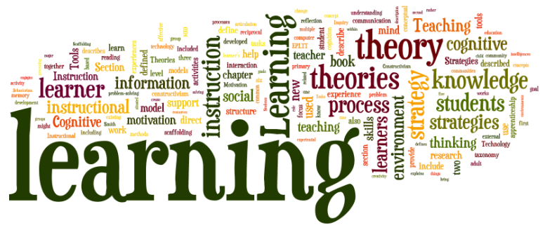
Preface
The learning process is a topic that has been discussed for a long time and many people in different fields such as philosophy, psychology, biology, cognitive sciences, computer science, etc. have published theories about it.

Slide 5
In this presentation, we have tried to present an overview of theories on this subject in the first step. In the following, we have presented two well-known theories about learning and the process of cognition in humans, which are the theories of Piaget and Vygotsky. Finally we introduced a game that has been implemented in NetLogo to model these two theories.

Slide 6
What is learning ?
Learning is the process of acquiring new understanding, knowledge, behaviors, skills, values, attitudes, and preferences.
Example: when you practice to be able to play music, the learning process takes place in your brain.

Slide 7

Theories about learning
Humans have been fascinated with learning and how it occurs for as long as the earliest civilizations were formed.

Slide 8
In general, theories about learning can be divided into two general categories: pre-industrial revolution and post-industrial revolution. In the pre-industrial revolution category, the main method was philosophy and theology, while in the post-industrial revolution category, it was science that played the main role in theorizing.

Slide 9
Pre-industrial revolution theories
It was assumed by the Ancient Egyptians and the Greek that intelligence, senses, and emotions were functions of the heart
Other Ancient Greek philosophers who lived a century or so later such as Socrates and his disciples, particularly Plato, believed that knowledge was innate and it could be accessed, or brought out, through reflection (Cordasco, 1976).

Slide 10
References
Comparison and Contrast of Piaget and Vygotsky's Theories: Yu-Chia Huang
History of Learning and Learning Theories: Looking back to Move Forward : https://edcrocks.com/2021/03/03/history-of-learning-and-learning-theories-looking-back-to-move-forward/
Complexity: A Guided Tour : Melanie Mitchell

